Slide 1
Current Lead and Copper Rule Requirements (LCRR) and Upcoming Enforcement Changes (LCRI)
Noah Barnett & Stephanie Galindo, Public Water Supply Section
Notes:
Hello everyone, my name is Noah Barnett and I’m one of the Lead and Copper Rule managers here in North Carolina. Today I’m going to be covering the current lead and copper rule requirements in effect from the LCRR as well as some upcoming changes to the way we will be enforcing things now that we have enough staffing capacity. Then I’ll pass it over to Stephanie to provide some information on the upcoming LCRI compliance and what changes we can expect with that.

Slide 2
Overview
Lead and Copper Rule Revisions (LCRR) – Current Requirements
  Initial Service Line Inventory
  Service Line Material Notices
  Lead Action Level Exceedance (ALE) Tier 1 (24-Hour) Public Notification
  Revised Lead Health Effects Language
Enforcement Changes – Starting January 1st, 2026
  Sampling
  CCTs
LCRI Handoff
Department of Environmental Quality
Notes:
First a quick overview of todays' talk. To start us off I will be talking about the changes that went into effect last October with the compliance date for the LCRR. We have 4 areas to cover in that section. Then I’ll move on to a couple enforcement changes we will be implementing starting the beginning of 2026. After that I’m going to pass it over to Stephanie to tell us about what will be changing as we implement the LCRI in 2027 and what systems need to prepare for in that.

Slide 3
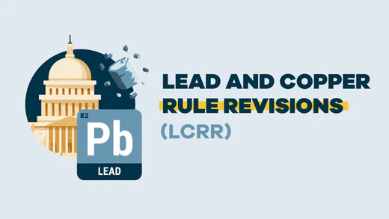
Lead and Copper Rule Revisions (LCRR)
Notes:
Okay, Let’s go ahead and get started with the current rules.

Slide 4
Lead and Copper Rule Revisions (LCRR)
Original compliance date for the LCRR was January 16, 2024.
The compliance date was moved to October 16, 2024 as EPA reviewed and “improved” the rule.
Regardless of the modifications in the LCRI, some LCRR’s requirements went into effect on the October 16, 2024 compliance date. These included:
  Initial Service Line Inventory
  Service Line Material Notices – Tier 3 PN for failure to notify
  Lead Action Level Exceedance (ALE) Tier 1 (24-Hour) Public Notification
  Revised Lead Health Effects Language
Department of Environmental Quality
Notes:
First a little history recap. In Early 2021 the LCRR was published to the federal register and it had an original compliance date of Jan. 16th 2024. Not long after it was published, the EPA decided to "Improve" the rule which lead to the LCRI.
Due to this many of the changes that were originally proposed in the LCRR were pushed back until the LCRI compliance date but a few of them went into effect on October 16th 2024. These include the requirements for an initial service line inventory and their associated material notices, the 24-hour Tier 1 Public Notification, and new health effects language for all the lead consumer notices, public education, and public notices.

Slide 5
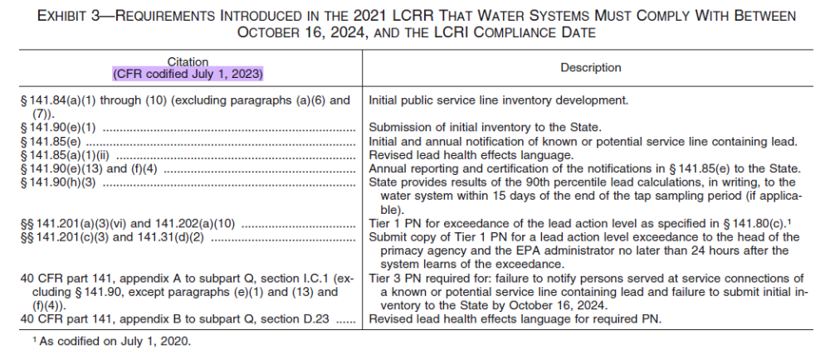
Lead and Copper Rule Revisions (LCRR)
Original compliance date for the LCRR was January 16, 2024.
The compliance date was moved to October 16, 2024 as EPA reviewed and “improved” the rule.
Regardless of the modifications in the LCRI, some LCRR’s requirements went into effect on the October 16, 2024 compliance date. These included:
  Initial Service Line Inventory
  Service Line Material Notices
  Lead Action Level Exceedance (ALE) Tier 1 (24-Hour) Public Notification
  Revised Lead Health Effects Language
Department of Environmental Quality
Notes:
Um, I like tables that help simplify and organize data so here’s a reference table of everything from the LCRR that is in effect between the October LCRR 2024 compliance date and the LCRI compliance date in November of ’27. It may not look like it but for us this really boils down to those 4 main changes. The one change listed here that I’m not covering is the 90th percentile and that’s because we already provide that as soon as it’s been calculated through drinking water watch.

Slide 6
Initial Service Line Inventory
The LCRR required systems subject to the L&C rule develop an inventory of all service line connections, both system-owned and customer-owned, by the compliance date of October 16, 2024.
Based on the service line material of both the system-owned and customer-owned portions of the service line, each service was classified as one of four material types, by rule:
  Lead
  Galvanized Requiring Replacement (GRR)
  Unknown Material
  Non-Lead
Water systems in NC completed an inventory template and submitted their inventory through the Service Line Inventory Submission Portal application.
https://www.deq.nc.gov/about/divisions/water-resources/drinking-water/lead-service-line-inventory
https://pws.ncwater.org/SLIWeb/pages/default.aspx
Department of Environmental Quality
Notes:
Let’s talk about the “Initial” Service line inventory. These are the inventories that were due on Oct 16th of last year and are supposed to include information for each service line in the system identifying the location and whether it is made of Lead, Galvanized Requiring Replacement, or non-lead material. Or that the material is unknown. The majority of water systems have completed their inventories but we still have about 47 that have yet to get those to us. We will need systems to continue to complete those inventories using the appropriate template from the lead service line inventory webpage and uploading it to the submission portal until we get the GIS submission system up and running in roughly 7 months. After that we will want systems to modify the data through our new portal which will have the ability for systems to use geocoded data, upload a spreadsheet, or modify the data directly through a table and map.
The initial inventory, technically, does not need to be updated annually. However, under some circumstances we will need them to update those but I’ll get to that in a minute.

Slide 7
Initial Service Line Inventory
2,329 (98.02%) inventories out of the 2,376 required have been received as of 10/07/2025.
  47 (1.98%) Outstanding
Of the inventories received so far, 3,624,332 total service lines have been reported. The material breakdown of these services lines is as follows:
  Lead – 289 (0.01%)
  GRR – 12,820 (0.35%)
  Unknown Material – 801,054 (22.03%)
  Non-Lead – 2,822,107 (77.61%)
These inventories have been renamed the “initial” service line inventories, as the LCRI added additional inventory requirements as part of a new “baseline” inventory
  Connectors
  Annual Updating
Department of Environmental Quality
Notes:
Like I said we are still missing 47 systems with the city of Rockingham and Dan River being the largest outstanding. That said, as of the 7th over 98% of the water systems we manage had completed submission of their inventories. Some good news for our state is we’ve found a very low percentage of lead lines. Out of the over 3 and a half million service line reported only 289 lead lines having been found. As we can see here the main materials are non-lead but we do still have around 22 % of the lines that have yet to be identified.
So I make a point that this is the "Initial" service line inventory because the LCRI has another inventory requirement called the “Baseline” inventory which adds connectors like pigtails and goosenecks along with annual updating. All the inventory reporting requirements for the upcoming LCRI will be incorporated into the new GIS portal when it goes live and, in case your worried that you will need to reenter the data, all the information we have already collected will be prepopulated in it.

Slide 8
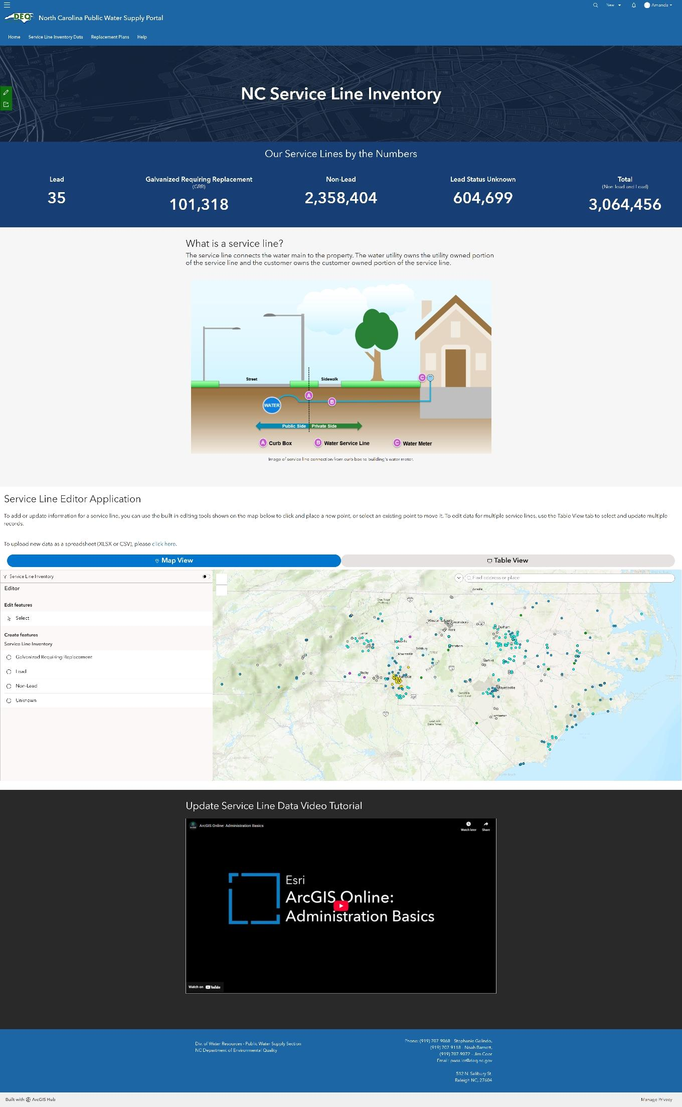
Notes:
Okay I keep mentioning the GIS dashboard so I should give you a little peek. This is fresh from development. Here is a look at the initial splash page a person will see when they go onto the GIS system.

Slide 9
Notes:
As you see, up here at the top, there’s a general overview of the service lines. This is showing the data for all systems in the state but if a water system was logged in, they would see the overview for that system. Below that we have some general information. To be honest I’m not sure what will be here when a water system is logged in but as we scroll down.

Slide 10
Notes:
We get to the meat of the application. Here we have the option to click to upload a spreadsheet or we can continue down and work from either the map or table view. In the map view we can select a location on the map to edit inventory data or we can create a new service line entry to the inventory by selecting what type of service line it is then entering the relevant information. Down here at the bottom of the page we will have some tutorials for how to upload, download, and edit data on the system. This system will also qualify as your online or public inventory so you will not need to have another location where it is available to the public. You do still need to keep copies of the data just like all other documents for lead and copper for the required 12 years.

Slide 11
Service Line Material Notices
The LCRR requires that a system send a notice to all customers served by lead, GRR, or unknown material service lines annually.
  NC interpreted annually as by the end of the calendar year.
Water systems required to certify distribution of notices to customers within the proper timeframe and provide a copy of the notices distributed to the state by July 1 of the following year.
Each notice must include the following information, by rule:
  A statement that the service line is lead, GRR, or of unknown material
  An explanation of the health effects of lead as specified in the rule (new language)
  Steps persons at the service connection can take to reduce exposure to lead in drinking water
  Information about opportunities to replace (lead and GRR), programs to finance replacement (lead), and verify the service line material (unknown material)
Department of Environmental Quality
Notes:
Now on to the material notices. These notices need to be distributed annually to locations served by Lead, GRR, or Unknown service lines and here in north Carolina we are going with the end of the calendar year as the annual deadline for those notices to be distributed. The deadline for those notices to be submit to ECERT is July 1st of the following year. If anyone needs them, templates for each notice type can be found on the Lead Service Line Inventory webpage. I have been asked about using a custom template for these. This is acceptable but we will need those to be approved before they are distributed. If a group chooses to use their own notice, there are 4 sections that are required by the rule. Those are:
a statement of the material type (Unknown, GRR, Lead)
The new health effects language
Steps to reduce exposure
Replacement information including ways to identify unknown materials, info about replacement opportunities for GRR, or info about financing and replacement opportunities for lead lines.
If this is an option your group would like to pursue please reach out so we can work together to ensure your template meets all the requirements.

Slide 12
Service Line Material Notices
Service line material notices must be distributed annually, so replacing lead or GRR services lines, and/or confirming the material of unknown material services lines will reduce the number of notices required to be issued.
Service line material notice templates are available on the Public Water Supply Section’s website
  https://www.deq.nc.gov/about/divisions/water-resources/drinking-water/lead-service-line-inventory
Notices should be submitted to the Public Water Supply Section through our online ECERT application (https://pws.ncwater.org/ECERT/pages/default.aspx).
Water systems with no lead, GRR, or unknown material services lines do not have to provide notices to customers, but they must still either make their inventory publicly accessible or provide a written statement declaring that the system is entirely composed of non-lead service lines and include a general description of the applicable sources used to make that determination.
Department of Environmental Quality
Notes:
Right so, as I mentioned these notices need to be distributed annually and we expect systems to identify unknowns as well as start replacing known lead and GRR which will help reduce the number of notices that need to be sent out each year. However, this is where the requirement for systems to update the inventory comes back into effect. The number of notices sent out needs to match the number for that type of material in the inventory we have on file. This means that a system will need to update the inventory if they send out a different number of notices then they did last year. Until the GIS system is available, we want systems to use the inventory templates they did previously and upload it through the submission portal that was used previously.
For those systems that have no lead, GRR, or unknowns left in the system they will be able to just declare they are entirely non-lead through a statement in the CCR and online if they need to post the inventory.

Slide 13
Lead ALE Tier 1 Public Notification
Now that LCRR compliance date of October 16, 2024 has passed, water systems are now required to issue a Tier 1 public notification to customers if the 90th percentile lead level exceeds the lead action level of 0.015 mg/L (15 ppb).
  As a reminder, a Tier 1 public notification requires the notice to distributed to customers within 24 hours of learning of the lead action level exceedance.
  The notice can be delivered to customers by broadcast media (radio/television), posting in conspicuous locations through the service areas, and/or hand delivery to all persons served by the system.
The Lead Action Level Exceedance Tier 1 Public Notice template is available on the Public Water Supply Section’s website
  https://www.deq.nc.gov/about/divisions/water-resources/drinking-water/lead-service-line-inventory.
After delivering to customers, certified notice should be submitted via email to both pwss.lcr@deq.nc.gov and LeadALE@EPA.gov.A new module is currently under development within our web-based ECERT application for submission of these lead action level exceedance public notices, which will be available soon.
Department of Environmental Quality
Notes:
Okay now for a fun one. As most of you probably know, the Action Level is calculated based on all the samples taken during the sampling period. After all the samples have been taken and a water system finds they have exceeded the lead Action level they need to send out a tier 1 public notice. This is the same kind of notice that goes out when a system violates the MCL for E. coli. or total coliforms.
The way the rule reads is that the notices need to be sent out within 24 hours of the system learning of the exceedance. Systems should learn of this when they get the last of their results back from the laboratory and get it out with the required 24-hour lead SPN. When this happens the system will probably hear from the regional office who will help guide systems through the compliance process then from us. For us at the central office, we will be running a compliance check on this at the end of the monitoring period to catch those that failed to distribute the notices. Because of the short time frame for this we will be notifying systems using email and from the time we send out the violation notice the system has 24 hours to provide a copy of the notice to both the state and EPA using the email addresses here and 10 days to provide certification that the notices were distributed as required. Believe it or not we have some templates for this which can be found on our lead service line inventory webpage. Again when those notices are required, the water system needs to submit the data to both the state and the EPA. For now that is done by email but in the future we will have a module in ECERT for them.

Slide 14
Revised Lead Health Effects Language
Lead Health Effects Language Under the Lead and Copper Rule (LCR)
  Infants and children who drink water containing lead in excess of the action level could experience delays in their physical or mental development. Children could show slight deficits in attention span and learning abilities. Adults who drink this water over many years could develop kidney problems or high blood pressure.
Lead Health Effects Language Under the Lead and Copper Rule Revisions (LCRR)
  Exposure to lead in drinking water can cause serious health effects in all age groups. Infants and children can have decreases in IQ and attention span. Lead exposure can lead to new learning and behavior problems or exacerbate existing learning and behavior problems. The children of women who are exposed to lead before or during pregnancy can have increased risk of these adverse health effects. Adults can have increased risks of heart disease, high blood pressure, kidney or nervous system problems.
Department of Environmental Quality
Notes:
Now a quick note on the updated health effects language. The language has been changed and is a bit more explicit and strongly worded to emphasize risks associated with lead exposure. This language will be in use until the LCRI compliance date when it changes again.

Slide 15
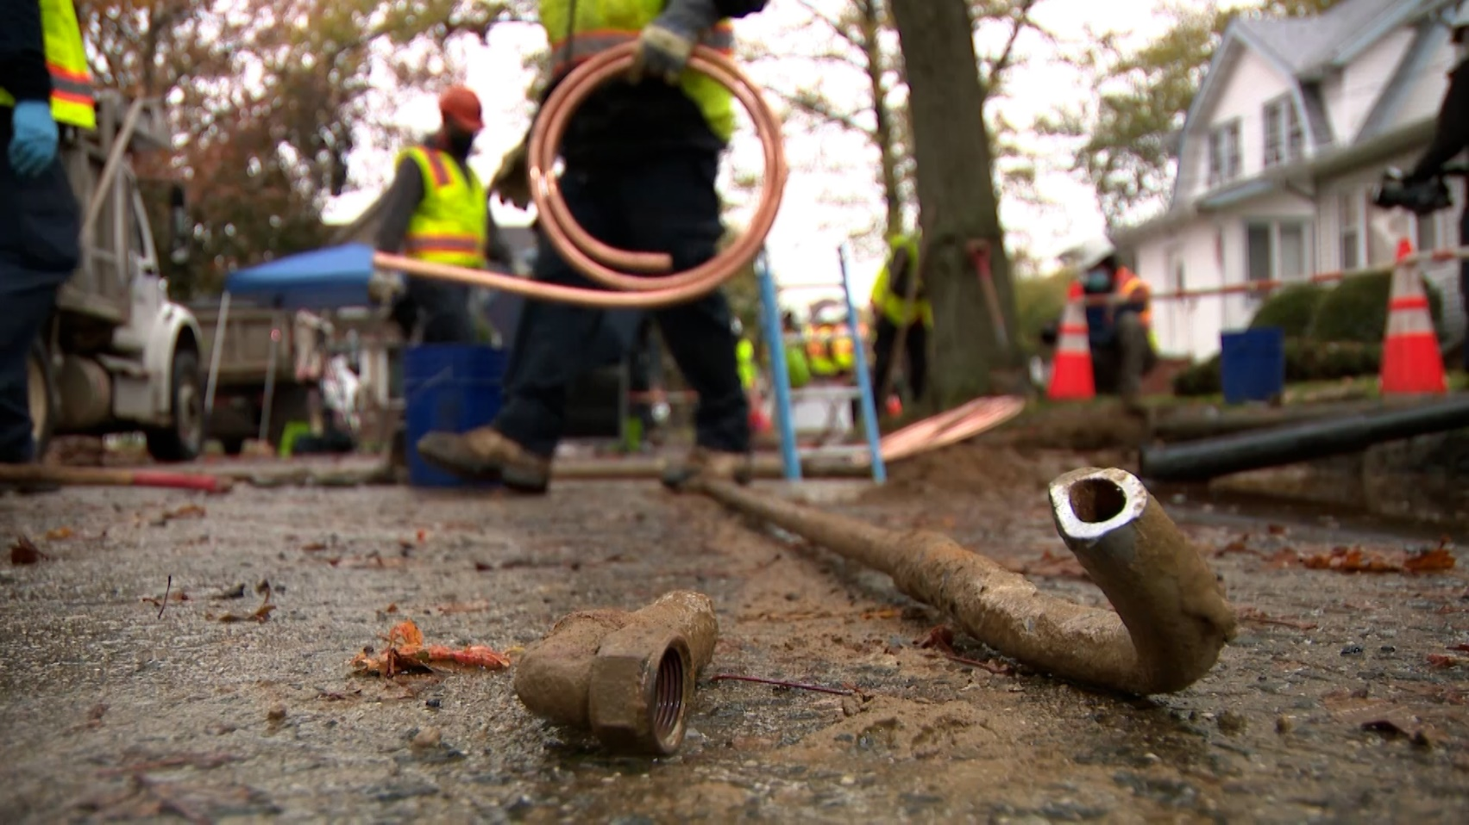
Enforcement Changes - Starting (Jan 1, 2026)
Notes:
Alright last bit of just listening to me talk. We have a few changes to enforcement that will be starting the beginning of next year.

Slide 16
Sampling
Sampling Data:
  Tap locations
    Kitchen or Bathroom Sink (Residential)
    Indoor tap typically used to draw water for consumption (non-residential)
  Duplicate Sites
  Site in Sample Pool
Site Pools:
  Correct Site #s
  Location Codes (ie A01)
  Update as Needed Online
  https://www.ncwater.org/?page=679
Department of Environmental Quality
Notes:
First is the sample data that is associated with each compliant lead and copper tap monitoring sample. For a while we have not had the staffing capacity to manage sampling data but now that we have a large enough team we will start too.
At the beginning of the year we will start invalidating samples that do not show what tap location they were sourced from. For a residential building the sample needs to come from a cold water kitchen or bathroom sink tap. For a non-residential site the sample needs to come from an indoor tap typically used to draw water for consumption. Some systems may have sites where water is not drawn from indoor taps for consumption but may be from an outside tap. These systems will need to get in touch with us for the samples to be accepted as compliant. Moving forward those systems may be asked to include the exception information in the comments so we don’t need to go back and forth with them. We will also be watching for duplicate sites and to ensure that the sites sampled are listed in the sample pool we have on file in the data acquisition portal.
Speaking of the pools, we are also going to start to make sure we have these and there are a few reasons we are starting to enforce this. First, with the “initial” inventory that was due last year some systems found they need to update the tiers listed in their system and because of this they will also need to correct their site plan. Another reason is because when the compliance date for the LCRI arrives many systems who are on reduced monitoring will be placed back on standard monitoring which requires double the number of samples. But the main reason is it’s required by 141.86, and we use it to ensure samples were taken from the proper locations ie highest tiers available, 50% from LSL if present, from a Residential or Non-Residential tap, etc.
The sample pools can be updated by the water systems as needed just by going to the data acquisition portal and signing in with the water system invite code. The pool needs to contain at least enough sites for the system when it’s on reduced monitoring but it would be best to have a few extra in case the site is inaccessible for some reason. You never know, maybe they just won the lottery. The sites also need to be coded correctly with a 3 digit code like I show here.
Last thing here, we are going to start sending out penalties at the beginning of the year and included in that we are also going to be going through outstanding CCT installations and proceding with enforcement.

Slide 17
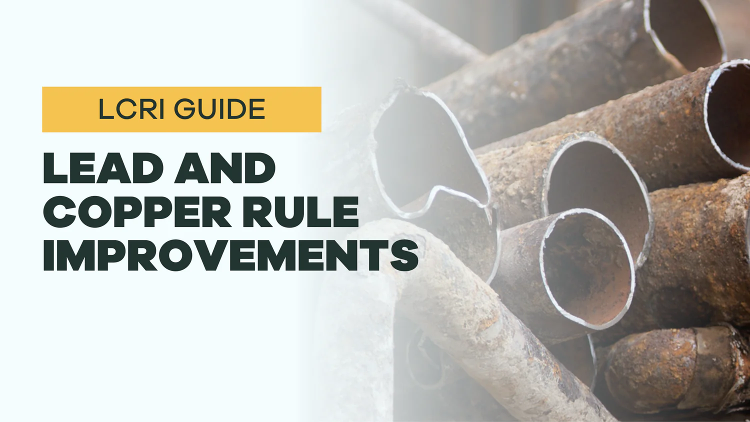
Lead and Copper Rule Improvements (LCRI)
LCRI
Notes:
Okay now I'm going to pass it over to Stephanie to learn about the improvements found in the LCRI.
At the end we can take some questions.
Hello everyone, my name is Stephanie Galindo, and I will be covering the LCRI section of this presentation. I am the new Environmental Program Consultant for the Lead and Copper team, and I have been tasked with learning this rule front to back. Now, I have only been in this position for a few months, so I am still learning, so please bear with me if I can’t fully answer your questions at the end of this presentation. I may need to do a little research to be confident. Now, let’s get into it.

Slide 18
Lead and Copper Rule Improvements (LCRI)
The final LCRI was published to the Federal Register on October 30, 2024.
Compliance date for the LCRI is November 1, 2027.
A general overview of the LCRI’s requirements include:
Lead Action Level Lowered
Revised Tiering Criteria
Monitoring Requirements and 90th Percentile Changes
Corrosion Control Treatment (CCT) Changes
Water Quality Parameter (WQP) Monitoring Changes
Distribution System and Site Assessment (DSSA) Changes
Small System Compliance Flexibility
Public Education and Outreach Changes
Consumer Confidence Report (CCR) Changes
Baseline Service Line Inventory
Inventory Validation
Lead Service Line Replacement Plans
School and Child Care Facility Sampling
Department of Environmental Quality
Notes:
The final LCRI was published to the Federal Register on October 30, 2024, and has a compliance date of November 1, 2027. However, the effective date of December 30, 2024, marked the start of planning and activities related to lead pipe replacement, including your inventory updates and replacement plans. The following topics listed below are what will be covered during this presentation today. We’ll specifically go through each one by one.

Slide 19
Lead Action Level Lowered
The final LCRI lowers the 90th percentile lead action level from 0.015 mg/L (15 ppb) under the current rule to 0.010 mg/L (10 ppb) under the final rule.
Compliance date for the new lead action level is November 1, 2027.
The 90th percentile copper action level remains at 1.3 mg/L (1.3 ppm) under the final rule.
15 ppb
10 ppb
Department of Environmental Quality
Notes:
With the final LCRI, the 90th percentile lead action level has been lowered to 0.010 mg/L or 10 parts per billion. The 90th percentile copper level will remain the same at 1.3 mg/L or 1.3 parts per million.

Slide 20
Revised Tiering Criteria
The tiering criteria for sample sites for Non-Transient Non-Community Water Systems (NTNCWS) and Community Water Systems (CWS) have been combined in the final LCRI:
Tier 1 – single family homes with premise plumbing made of lead and/or served by a lead service line.​
Tier 2 – buildings, including multifamily homes, with premise plumbing made of lead and/or served by a lead service line.​
Tier 3 – include single family homes that are either:​ Sites served by a lead connectors​ Sites served by a galvanized service line ever downstream of an LSL or lead connector, or​ Sites with galvanized premise plumbing ever downstream of an LSL or lead connector.​
Tier 4 – sites containing copper pipes with lead solder installed before the state lead ban (March 1987).​
Tier 5 – sites that are representative of locations throughout​ the distribution system.
Department of Environmental Quality
Notes:
Under the LCRI, site tiering has been revised. Sampling sites must be selected from the highest tier available. Tier 1 being the highest, and Tier 5 being the lowest.
Now, let’s go through the definition of each tier. Tier 1 refers to single family homes with pluming made of lead and/or served by a lead service line. Tier 2 includes buildings and multifamily homes with plumbing made of lead and/or lead service lines. Tier 3 are single family homes that are either served by lead connectors, galvanized service lines or plumbing that have ever been downstream of a lead service line or lead connector. Tier 4 would be sites that contain copper pipes with lead solder installed before the lead ban. And lastly, Tier 5 sites are locations throughout the distribution system.
To select your sampling sites, you will use the information you gathered for your service line inventory. So, here is your criteria for selecting your sampling sites. 1. Use the information regarding materials of service lines and connectors from your service line inventory. 2. Select locations from the highest tier. 3. You may not select sites or taps with installed POE devices, except in systems using them at all service connections. 4. Systems without a large enough number of sites from a higher tier, may samples sites from the next highest tier.
Systems with fewer than 5 sites with drinking water taps must collect at least one samples from each tap and collect additional samples from those taps on different days during the sampling period.
System service sites with premise plumbing made of lead and/or served by a lead service line must collect all samples for monitoring. If a system cannot identify enough sampling sites, they must still collect samples from every site available.
A site is considered “available” unless a customer refuses to participate or if the system has made at least two outreach attempts and has not received a response. The number of refusals and non-responses must be submitted to the State.

Slide 21
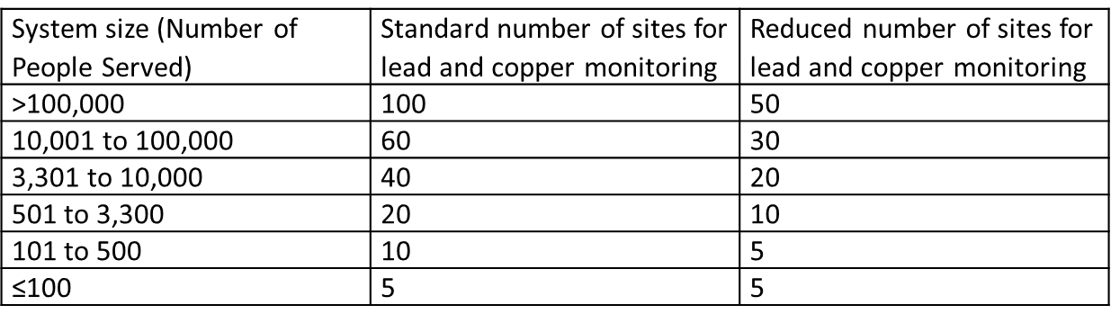
Monitoring Requirements
Lead and Copper Sampling
  Same number of required sample sites.
  Same timeframe for monitoring:
    January – June and July – December (6-month monitoring)
    June – September (Annual and 3-year monitoring)
Department of Environmental Quality
Notes:
Now let's move on to monitoring requirements. For sampling, the standard and reduced number of sites to be sampled has stayed the same, as well as the monitoring period. January to June and July to December for 6-month monitoring, and June to September for annual and 3-year monitoring.

Slide 22
Monitoring Requirements
Water Quality Parameter Monitoring
  All large and medium water systems with corrosion control treatment (unless deemed optimized) and all small and medium water systems that exceed the lead or copper action level must sample and monitor water quality parameters in addition to lead and copper.
  Sites that are selected for this sampling can be the same or different from the tap sampling sites chosen for lead and copper, but they must be included in the site sample plan.
  Samples to be collected at distribution taps (representing water quality throughout the distribution system) and entry point(s) to the distribution system.
  Parameters analyzed in samples: pH, alkalinity, orthophosphate (if used), silica (if used) and any additional parameters specified by the State.
System size (Number of people served) | Standard minimum number of sites for water quality parameters | Reduced minimum number of sites for water quality parameters
>100,00 | 25 | 10
10,001 to 100,000 | 10 | 7
3,301 to 10,000 | 3 | 3
501 to 3,300 | 2 | 2
101 to 500 | 1 | 1
≤100 | 1 | 1
Notes:
With the final LCRI more information has been provided regarding water quality parameter monitoring. This is for all large and medium water systems with CCT (unless deemed optimized) and all small and medium systems that exceed the lead or copper action level. Sites that are chosen for this sampling can be the same or different from the tap sampling sites for lead and copper but must be included in the site plan. The samples will need to be collected at distribution taps and entry points to the distribution system.
For standard monitoring, systems must collect two distribution samples each monitoring period and collect samples from additional sites as a result of the distribution system and site assessment.
Large systems without CCT must begin WQPs during the first two six-month monitoring periods, no later than January 1, after the system either becomes a large system or exceeds the practical quantitation limit for lead. Medium systems without CCT exceeding lead or copper action level must begin monitoring for distribution system and entry point WQPs for two consecutive six-month periods beginning the month immediately follow action level exceedance. Small systems that exceed the lead or copper action level must begin monitoring for system and WQPs (such as pH and Alkalinity) for two consecutive six-month periods following the end of the monitoring period exceedance.

Slide 23
Monitoring Requirements
Monitoring Schedules
Systems with known lead and/or GRR service lines in their inventory on November 1, 2027, must resume a standard monitoring schedule (every 6 months).
  With the exception of systems that meet certain tap sampling requirements before the compliance date.
Systems with no lead or GRR service lines in their inventory on November 1, 2027, can remain on reduced monitoring and must start standard monitoring if they identify a lead or GRR service line in the future.
Thereafter, the monitoring schedule is based on the 90th percentile for lead and copper. Systems may retain or qualify for reduced monitoring based on the number of consecutive tap monitoring periods:
  90th percentile ≤ action level for 2 consecutive 6-month periods: Annual monitoring at standard number of sites for lead and reduced number of sites for copper.
  90th percentile < practical quantitation limit (PQL) for 2 consecutive periods: Triennial monitoring at the reduced number of sites for both lead and copper.
Department of Environmental Quality
Notes:
Systems that have known lead and/or GRR service lines by the compliance date must resume the standard monitoring schedule. Unless the system has met the following criteria: 1. The system conducts compliance monitoring of sites that meet correct priority tiering in accordance with the sampling sites criteria. 2. The system collects samples in accordance with the sample collection protocol. And 3. The system collects either first-liter or first-and-fifth-liter paired samples in accordance with the sample collection protocol.
Systems with no lead or GRR service lines in their inventory on the compliance date can continue reduced monitoring but must start standard monitoring if any of those lines are found in the future.
After the compliance date of Nov. 1, 2027, the monitoring schedule is based on the 90th percentile. For percentiles that are less than or equal to the action level for 2 consecutive 6-month periods, annual monitoring at standard number of sites for lead and reduced number for copper. Percentiles less than the practical quantitation limit for 2 consecutive periods, triennial monitoring at reduced number of sites for lead and copper.

Slide 24
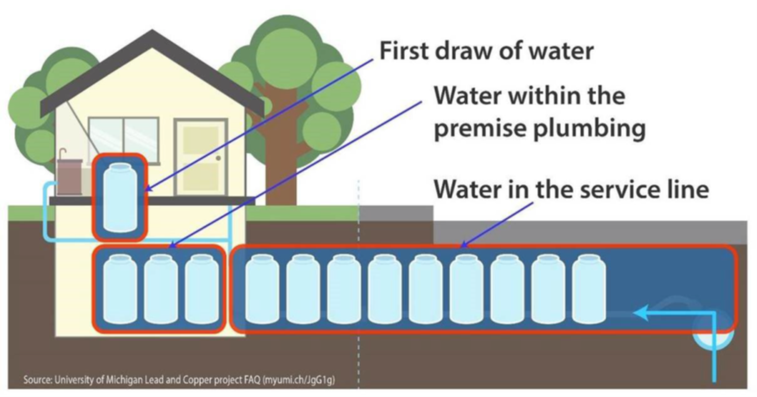
Monitoring Requirements
Still a 1-liter sample after at least 6 hours of stagnation.
Residential housing samples must still be collected from a kitchen or bathroom tap, and non-residential samples must still be collected from a tap typically used for consumption.
1st and 5th Liter Samples
  For ALL sites, the 1st liter sample must be analyzed for lead and copper.
  For Tier 1 and 2 sites only, a 5th liter sample must also be analyzed for lead (higher value used for 90th percentile calculation).
Department of Environmental Quality
Notes:
With the LCRI, there is still a 1-litter sample taken, but now with a wide-mouth bottle after at least 6 hours of stagnation. Residential samples must still be collected from an interior kitchen or bathroom tap and non-residential samples must be collected from an interior cold water tap used for human consumption. All sites must analyze the 1st liter sample for lead and copper, but only Tier 1 and 2 sites analyze the 5th liter sample for lead. For sites served by a lead service line, an additional fifth-liter sample must be collected at the same time as the first-liter sample and must be analyzed for lead.
These samples may be collected by the system, or the system may allow members of the public to collect samples, as long as instructions are provided that contain all of the information I just mentioned. Or to be sited specifically, 40 CFR 148.86 (b)(1).

Slide 25
Monitoring Requirements
Requirement for replacement sampling sites to be selected within reasonable proximity has been removed.
Clarifies when sites are considered no longer available for sampling after customer refusal or nonresponse after two outreach attempts.
  Customer refusal or nonresponse numbers must be submitted and certified by the State.
Department of Environmental Quality
Notes:
The requirement for replacement sampling sites selected within reasonable proximity has been removed. The water system must collect replacement samples for any samples that are invalidated. Any replacement samples taken must be done so as soon as possible, but no later than 20 after the date the State notifies the system of an invalidated sample, or by the end of the sampling period, whichever occurs later. The replacement samples must be taken at the same locations, except when the sample is invalidated due to an error in meeting the site selection criteria, or when a system cannot gain access for sampling.
There is also now a clarification when sites are considered no longer available for sampling after customer refusal or nonresponse after two outreach attempts, but these numbers must be submitted and certified by the State. Systems may continue conducting outreach at sites considered unavailable and may subsequently add such sites to the site sample plan for any reason, such as receiving a service initiation request from a new property owner or occupant or receiving a new consumer request for sampling. A system without a large enough number of sites from a higher tier to meet the number of sites required may sample sites from the next highest tier. For water systems where Tier 2 sites comprise at least 20 percent of the residential structures served by the community water system, Tier 2 sites may be sampled even when Tier 1 sites are available.

Slide 26
90th Percentile Calculation
  Calculation for systems with sufficient Tier 1 and 2 sites to meet the minimum number of required sample sites.
    For lead, use the higher result from the 1st or 5th liter for each site. Calculate the 90th percentile as normal.
    For copper, use the 1st liter result for all sites and calculate the 90th percentile as normal.
    Cannot use any samples collected from Tier 3, 4, or 5 sites in this calculation.
  Calculation for systems with insufficient Tier 1 and 2 sites to meet the minimum number of required sample sites.
    For lead, use the higher result from the 1st or 5th liter for each Tier 1 and 2 site and the highest samples from Tier 3, 4, or 5 until minimum is met. Calculate the 90th percentile.
    For copper, use all 1st liter samples from Tier 1 and 2 sites first, then highest samples from Tier 3, 4, or 5 until minimum is met. Calculate the 90th percentile.
    Any remaining Tier 3, 4, or 5 samples cannot be included in the 90th percentile calculations.
  For systems with only Tier 3, 4, or 5 sites, all lead and copper samples must be included in the 90th percentile calculation.
  For systems with fewer than five samples, the highest concentration is considered the 90th percentile.
Department of Environmental Quality
Notes:
Systems with sufficient Tier 1 and 2 sites, for lead, use the higher result from the 1st or 5th liter for each site, for copper, use the 1st liter results for all sites. Calculate the 90th percentile as normal for both.
Systems with insufficient Tier 1 and 2 sites, for lead, use the higher result from the 1st or 5th liter for each Tier 1 and 2 sites, then highest samples from Tier 3, 4, or 5 until the minimum is met. For copper, use the 1st liter samples from Tier 1 and 2 sites first, then the highest samples from Tier 3, 4, or 5 until the minimum is met.
For systems with only Tier 3, 4 or 5 sites, all lead and copper samples must be included in the 90th percentile calculation. For systems with fewer than five samples, the highest concentration is considered the 90th percentile.

Slide 27
Corrosion Control Treatment (CCT)
With Corrosion Control Treatment | Without Corrosion Control Treatment
Step 1: Initiate mandatory pipe rig/loop or CCT study or treatment recommendation | Step 1: Initiate mandatory pipe rig/loop or CCT study or treatment recommendation
Step 2: State requires CCT study or State designates re-optimized OCCT | Step 2: State requires CCT study or State designates re-optimized OCCT
Step 3: Any system with lead lines exceeding lead levels must complete pipe/rig loop CCTS and recommend re-optimized OCCT within 30 months | Step 3: Study duration
Step 4: State designation of re-optimized OCCT based on CCTS results | Step 4: State designation of OCCT based on CCT study results
Step 5: Install re-optimized OCT within 1 year after step 4 | Step 5: OCCT installation deadlines. Systems must install OCCT within 24 hours after State designates OCCT
Step 6: Standard monitoring for two monitoring periods and WQP monitoring | Step 6: Follow-up monitoring
Step 7: State sets OWQPs. State reviews systems re-optimized OCCT and designates OWQPs | Step 7: State sets OWQPs
Step 8: Systems meet OWQPs to demonstrate compliance | Step 8: Systems meet OWPS to demonstrate compliance
Notes:
All systems are required to install, optimize or re-optimize optimal corrosion control treatment.
On this slide I have provided the treatment steps and deadlines that systems will need to follow whether they have CCT or not.
All of this information can be found in 141.81(d) and (e), but I’ll give you a little bit of time to take a picture if you’d like.

Slide 28
Corrosion Control Treatment (CCT)
System Size | Tap Sample Results | Systems with Existing CCT | System without Existing CCT
Large (> 50,000) | 90th percentile Pb > AL | Must do CCS; systems with LSLs must conduct harvested pipe rig/loop study | Must do CCS; systems with LSLs must conduct harvested pipe rig/loop study
 | 90th percentile Cu > AL | Must do CCS | Must do CCS
 | 90th percentile Pb > PQL (5 µg/L) but ≤ AL | State may require a CCS | Must do CCS
Medium (10,000 – 50,000) | 90th percentile Pb > AL | Systems with LSLs must conduct harvested pipe rig/loop study; state may require systems without LSLs to conduct a CCS | Systems with LSLs must conduct harvested pipe rig/loop study; state may require systems without LSLs to conduct a CCS
 | 90th percentile Cu > AL | State may require a CCS | State may require a CCS
Notes:
And if you happen to like tables, here is another one showing you similar information, but from a large and medium system process.

Slide 29
Corrosion Control Treatment (CCT)
For Systems that Exceed the 90th Percentile Lead Action Level (0.010 mg/L or 10 ppb)
Without CCT
  Must install CCT regardless of subsequent 90th percentile levels if CCT installation has started.​
With Optimized Corrosion Control Treatment (OCCT)
  Systems with OCCT and with lead and/or GRR service lines and are meeting Optimal Water Quality Parameters (OWQPs) need only re-optimize OCCT once after the compliance date.​
  Systems with OCCT that exceed the 90th percentile lead action level after removing all lead and/or GRR service lines will need to re-optimize again.
  Systems may be required to re-optimize if required by the State at any time, including from a modification of a State treatment determination of OCCT or upon adding a new source or long-term treatment change.
Department of Environmental Quality
Notes:
Systems that exceed the 90th percentile lead action level without CCT must install CCT regardless of the 90th percentile levels if CCT installation has started.
Systems that exceed with Optimized CCT and with lead and/or copper service lines and are meeting optimal quality parameters need only re-optimize OCCT once after the completion date.
Systems with OCCT that exceed the action level after removing all lead and/or GRR service lines will need to re-optimize again.
If required by the State, systems may be required to re-optimize.

Slide 30
Corrosion Control Treatment (CCT)
Systems with lead and/or GRR service lines can defer installing or re-optimizing OCCT if they replace 100% of their lead and GRR service lines within 5 years or less from the date they are triggered into CCT steps (must maintain CCT during 5-year period).​
Calcium carbonate stabilization option for CCT removed.​
Phosphate inhibitor must be orthophosphate.
Identifies systems that need to conduct a harvested pipe rig study.
  Large or medium systems with lead service lines and exceed the 90th percentile lead action level must harvest lead service lines from their distribution system and construct a flow through pipe rig, operating the rig with finished water.
  After completing the pipe rig study, the system must recommend OCCT to the State based on the results of the study.
Department of Environmental Quality
Notes:
Systems with lead and/or GRR service lines can defer installing or re-optimizing OCCT if they replace 100% of their lead and GRR lines within 5 years or less from the trigger date.
The LCRI has also removed the calcium carbonate stabilization option for CCT, the phosphate inhibitor must be orthophosphate, and it identifies systems that need to conduct a harvested pipe rig study. Large or medium systems with lead service lines and that exceed the 90th percentile lead level must harvest lead service lines from their distribution system and construct a flow through pipe rig, then operate with finished water. After completing the study, the system must recommend OCCT to the state based on the results of the study.

Slide 31
Water Quality Parameter (WQP) Monitoring
Systems with CCT (unless deemed optimized) serving > 10,000 persons must conduct regular WQP monitoring at entry points and within the distribution system.
Systems serving ≤ 10,000 persons and systems without CCT serving > 10,000 persons but ≤ 50,000 persons that exceed the lead and/or copper action level(s) must conduct WQP monitoring until they no longer exceed lead and/or copper action level(s) for 2 consecutive 6-month monitoring periods.
Systems without CCT serving > 10,000 persons but ≤ 50,000 persons that exceed the lead action level that are required to install CCT must continue to conduct WQP monitoring.
Department of Environmental Quality
Notes:
Now on to Water Quality Parameter Monitoring. Systems with CCT (unless deemed optimized) that are serving greater than 10,000 people must conduct regular WQP monitoring at entry points within the distribution system.
Systems serving less than or equal to 10,000 people and systems without CCT service greater than 10,000, but less than or equal to 50,000 people that exceed the lead and/or copper action levels must conduct WQP monitoring until they no longer exceed either action levels for 2 consecutive 6-month monitoring periods. Systems without CCT serving greater than 10,000 but less than or equal to 50,000 people that exceed the lead action level that are required to install CCT must continue to conduct WQP monitoring.

Slide 32
Distribution System and Site Assessment (DSSA)
Changes the name from “Find-and-Fix” to “Distribution System and Site Assessment” to describe this requirement more precisely.
Requirements for systems with individual tap samples > 0.010 mg/L lead:
  Conduct WQP monitoring at or near the site > 0.010 mg/L.
  Collect tap sample at the same tap sample site within 30 days.
    For lead service lines, collect any liter or sample volume.
  Perform needed corrective action.
  Document customer refusal or non-response after 2 attempts.
  Provide information to local and State health officials.
Clarifies that the distribution system sample location must be within a half mile radius of each site with a result > 0.010 mg/L.
Water systems without CCT are not required to collect WQP samples for the DSSA CCT assessment.
Department of Environmental Quality
Notes:
Now with the LCRI, “Find-and-Fix” has been changed to “Distribution System and Site Assessment” or DSSA. For systems with individual tap samples that are greater than the lead action level, they must conduct water quality parameter monitoring at or near the site exceeding the action level, then collect tap samples at the same tap sample site within 30 days. The system will then perform needed corrective action, document customer refusal or non-response after two attempts and lastly provide information to local state health officials. The Distribution System and Site Assessment clarifies that the distribution system sample location must be within a half mile radius of each site with an exceeding lead result. Water systems without CCT are not required to collect WQP samples for the DSSA CCT assessment. As for timing and delivery of DSSA information to local and State health agencies, community water systems must send the DSSA information and copies of public education in the previous year no later than July 1 of the following year, either by mail, email or other State approved method.

Slide 33
Small System Compliance Flexibility
Allows CWSs serving ≤ 3,300 persons and all NTNCWSs with 90th percentile levels > lead action level and ≤ copper action level to choose the following actions in lieu of CCT requirements to address lead with State approval:
Choose a compliance option: (1) provision and maintenance of Point of Use (POU) devices or (2) replacement of all lead-bearing plumbing materials.
Removes the compliance option under LCRR to conduct LSLR in 15 years. Otherwise, the system must meet the following CCT requirements:
With CCT: Collect WQPs and evaluate compliance options and OCCT.
No CCT: Evaluate compliance options and CCT.
Department of Environmental Quality
Notes:
There is now small system compliance flexibility that allows community water systems serving less than or equal to 3,300 people and all non-transient non-community water systems with 90th percentile levels greater than the lead action level, and less than or equal to the copper action level to choose their actions in lieu of CCT requirements to address lead. Option 1 is the provision and maintenance of point of use devices. Option 2 is the replacement of ALL lead-bearing plumbing materials.
The small system compliance flexibility has removed the compliance option to conduct lead service line replacement in 15 years. Instead, the system must meet CCT requirements. IF the system has corrosion control, they need to collect water quality parameters and evaluate compliance options and OCCT. If the system does not have corrosion control, they need to evaluate their compliance options and CCT.

Slide 34
Public Education and Outreach
Water systems must deliver consumer notice of lead and copper tap sampling results to consumers whenever their tap is sampled as soon as practicable but no later than 3 business days after receiving the results, regardless of the level.
Water systems with multiple lead action level exceedances (at least 3 action level exceedances in a 5-year period) must conduct additional public outreach activities and make filters available. Water systems must submit a filter distribution plan to the State within 60 days of the second action level exceedance, and the State will have 60 days to review it. The State has discretion to allow the system to discontinue outreach activities and filter provision earlier if it completes actions to reduce lead levels.
Water systems must offer to sample the tap for lead for any consumer with a lead, GRR, or unknown service line who requests it.
Department of Environmental Quality
Notes:
Next, we are going to talk about public education and outreach. Whenever a customers tap is sampled, water systems must deliver a notice of the lead and copper sampling results as soon as practicable, but no later than 3 business days after receiving the results, regardless of the level. In the past, this notification was due within 30 days, so this is a pretty significant change that should be noted and followed. This notification ensures transparency and timely communication with consumers about potential exposure risks.
Systems with multiple lead exceedances (at least 3 in a 5-year period) must conduct additional public outreach and provide filters. A filter distribution plan must be submitted to the State within 60 days of the SECOND exceedance, and the State has 60 days to review it.
Systems must offer to sample for lead for any customer with a lead, GRR or unknown service line who requests it.

Slide 35
Consumer Confidence Report (CCR) Information
Revises the mandatory lead health effects language and informational statement as well as includes additional information about risk of lead exposure in the informational statement about lead in the CCR to improve completeness and clarity.
CWSs must include a statement in the CCR about the system sampling requirements for lead in schools and child care facilities and direct the public to contact their school or child care facility for further information.
CWSs with lead, GRR, or unknown material service lines must include a statement in the CCR about how to access the service line inventory and replacement plan.
Department of Environmental Quality
Notes:
A few things have changed on the consumer confidence report. There has been revised language about lead health effects, risk of lead exposure and informational statement about lead in the CCR to improve clarity.
Community water systems must include a statement in their CCR about sampling requirements for lead in schools and childcare facilities and direct the public to contact the school or child care facility for more information.
Community water systems with lead, GRR, or unknown service lines must include a statement in the CCR about how to access the service line inventory and replacement plan.

Slide 36
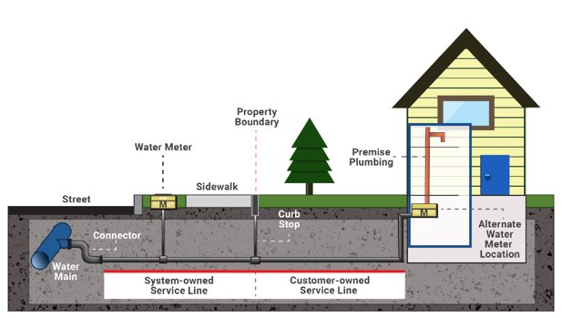
Baseline Service Line Inventory
An updated inventory, referred to as the “baseline inventory”, must include the material of connectors in addition to the service line materials, regardless of ownership status.
The LCRI defines a connector as a short segment of piping not exceeding three feet that can be bent and is used for connections between service piping, typically connecting the service line to the main.
Baseline inventories are due on the LCRI compliance date of November 1, 2027.
Department of Environmental Quality
Notes:
An updated inventory, now known as the baseline inventory will be due on the compliance date of November 1, 2027. It must include the materials of the connectors and service line materials. A connector is a short segment of piping not exceeding three feet that can be bent and is used for connections between service piping, connecting the service line to the main.
We are currently in the process of updating the previous template that was used for submittal of your initial inventory. We will keep everyone updated once we have a foreseeable release date for the baseline inventory template.

Slide 37
Baseline Service Line Inventory
Connectors must be classified as one of the following material within the baseline inventory:
  Lead
  Unknown
  No Connector Present
  Non-Lead
The baseline inventory and all subsequent annual updates must include the following:
  Number of each type of service line
  Number of lead and unknown connectors
  Number of full lead and GRR service line replacements in past year
  Number of partial lead and GRR service line replacements in past year
  Street address when available
Department of Environmental Quality
Notes:
The following material can be classified in the baseline inventory: Lead, unknown, no connector present or non-lead.
The baseline inventory and annual updates must include: the number of each type or service line, lead and unknown connectors, number of full and partial lead and GRR service line replacements in the past year and a street address when available.

Slide 38
Baseline Service Line Inventory
Just like the initial service line inventory, the baseline inventory must be made publicly accessible; and available online for systems serving greater than 50,000 people.
Systems must respond to customer inquiries on incorrect material categorizations within 60 days.
Systems must identify all unknown service lines by the applicable mandatory replacement deadline.
Department of Environmental Quality
Notes:
The same as before, the baseline inventory must be made publicly accessible and available online for systems that service more than 50,000 people.
Systems must respond to customer inquiries on incorrect material categorizations within 60 days.
All unknown service lines must be identified by the mandatory replacement deadline in 2037.

Slide 39
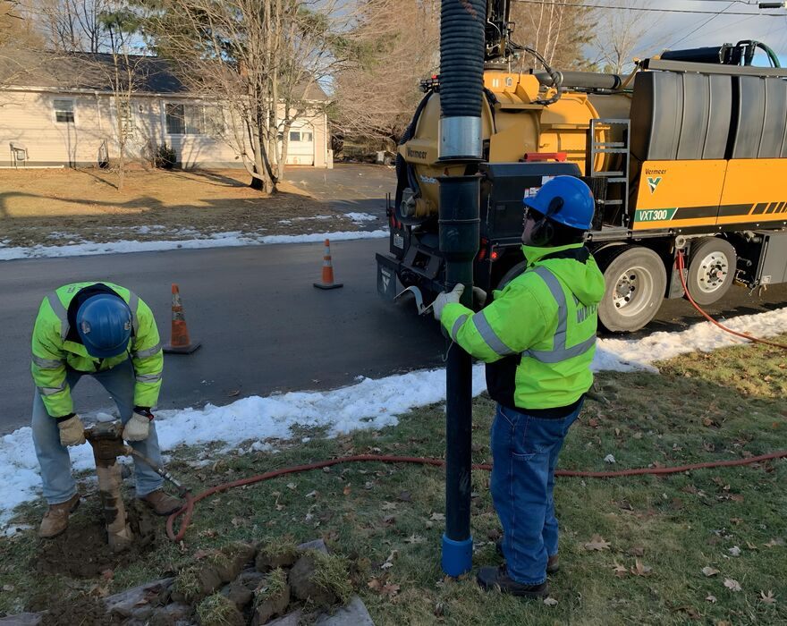
Inventory Validation
Systems must validate their methods to categorize non-lead service lines in their baseline inventory by December 31, 2034.
The validation pool includes all non-lead service lines except:
  Those installed after Federal, State, or local lead ban
  Those visually inspected at a minimum of two points on the pipe exterior
  Those previously replaced
Systems may submit previous validation efforts in lieu of the LCRI requirements if they are at least as stringent as the requirements (State discretion)
Department of Environmental Quality
Notes:
Inventory Validation methods to categorize non-lead service lines in their baseline inventory must be done by December 31, 2034.
The validation pool includes all non-lead service lines except: those installed after Federal, state or local lead ban, those visually inspected at a minimum of two points on the pipe exterior, and those previously placed. Systems can submit previous validation efforts in lieu of LCRI requirements , as long as they are as stringent as the requirements.

Slide 40
Lead Service Line Replacement Plans
Systems with lead, GRR, or unknown material service lines must develop a replacement plan by the LCRI compliance date of November 1, 2027. Required elements of the replacement plan include: ​
  Publicly accessible inventory (available online for systems serving >50,000 persons)​.
  The publicly available inventory must have locational identifier for each lead/GRR service line​.
  Strategy to inform customers and consumers about the plan and replacement program​.
  Identify legal requirements or water tariff agreement provisions that affect a system’s ability to gain access for full service line replacement.​
  Annually the plan must be revised with new/updated information and be submitted to the State​.
Replacement plan must include additional elements if the system has one or more lead-lined galvanized service lines or if the system is eligible for a deferred deadline.
Department of Environmental Quality
Notes:
A replacement plan must be submitted by November 1, 2027 for systems with lead, GRR or unknown material service lines. The plan must include: Publicly accessible inventory that must have locational identifier for each lead/GRR service line, a strategy to inform customers and consumers about the plan and replacement program, identify legal requirements or water tariff agreement provisions and revise the plan with new or updated information annually to the state.
Replacement plans must include additional elements if the system has one or more lead-lined galvanized service lines or if the system is eligible for a deferred deadline.

Slide 41
Lead Service Line Replacement Plans
By the LCRI compliance date of November 1, 2027, systems planning to use deferred deadlines must include earliest deadline and fastest feasible rate to replace lead and GRR.
No slower than 39 annual replacements per 1,000 service connections.​
By December 31, 2029, the State is required to determine if systems with a deferred deadlines are replacing service lines at the fastest feasible rate.​
Every three years, in addition to annual updates, systems with deferred deadlines must update why the replacement rate is still the fastest feasible.
Department of Environmental Quality
Notes:
Systems that are planning on using deferred deadlines must include earliest deadline and fastest feasible rate to replace lead and GRR by the compliance date.
This must not be slower than 39 annual replacements per 1,000 connections. The State is required to determine if systems with deferred deadlines are replacing service lines at the fastest feasible rate by December 31, 2029.
Every three years, along with annual updates, systems with deferred deadlines must update why the replacement rate is still the fastest feasible.

Slide 42
Lead Service Line Replacement Plans
Replacement requirements are independent of a system’s 90th percentile lead level.​
All CWSs and NTNCWSs must replace lead and GRR under their control within 10 years unless deferred.
Systems must replace service lines at a cumulative average annual rate of 10 percent, unless subject to a shortened or deferred deadline.​
Cumulative average replacement rate is applied to the total number of unknown, lead, and GRR service lines in the baseline inventory minus the number of unknown service lines that have been determined to be non-lead since the baseline inventory.
Department of Environmental Quality
Notes:
Replacement requirements are independent of 90th percentile lead levels. Within 10 years, all CWs and NTNCWS must replace lead and GRR lines, at an average rate of 10 percent annually, unless deferred. The replacement rate is applied to the total number of unknown, lead and GRR service lines in the baseline inventory minus the number of unknown service lines that have been determined to be non-lead since the baseline inventory.

Slide 43
Lead Service Line Replacement Plans
Systems required to annually replace more than 39 service lines per 1,000 connections are eligible for deferred deadlines longer than 10 years.​
States required to shorten deadline for systems where a shorter deadline is feasible.​
Where property owner consent is required to access the service line, systems must make a “reasonable effort” (at least 4 attempts) to engage property owners.​
Partial replacements are prohibited except for:
  emergency repairs
  infrastructure projects that impact service lines where the system does not have control
Systems conducting partial service line replacement, must make a “reasonable effort” to engage property owners about full service line replacements and offer to replace the remaining portion of the service line not under their control within 45 days if replaced in coordination with an emergency repair.
Department of Environmental Quality
Notes:
Systems required to annually replace more than 39 service lines per 1,000 connections are eligible for deferred deadlines longer than 10 years.​ The State is required to shorten the deadline for systems where a shorter deadline is feasible. A reasonable effort must be made to property owners where consent is required to access the service line.
There are two exceptions for partial replacements: emergency repairs and infrastructure projects that impact service lines where the system does not have control.
A reasonable effort must also be made to property owners about full service line replacement and offer to replace the remaining portion within 45 days if replaced in coordination with an emergency repair.

Slide 44
Lead Service Line Replacement Plans
Service Line Replacement Related Outreach
Provide annual notification to customers and all persons served by the water system at the service connection with a lead, GRR, or unknown material service line.
Provide notice and educational materials during water-related work that could disturb lead, GRR, or unknown service lines, including disturbances due to inventorying efforts, to consumers within 24 hours or before the service line is returned to service, and to customers within 30 days.
Provide filters to consumers for disturbances to a lead, GRR, or unknown material service lines caused by replacement of an inline water meter, water meter setter, connector, or water main.​
If CWS does not meet the mandatory replacement rate they must conduct additional public outreach activities to encourage customers with lead, GRR, and unknown service lines to participate in the service line replacement program.
Department of Environmental Quality
Notes:
Regarding outreach, systems will need to provide annual notifications to customers and all person served by the water system at the service connection with a lead, GRR or unknown material service line.
Notices and educational materials will need to be provided during water-related work that could disturb categorized lines, including disturbances to inventory efforts. These should be given to customers within 24 hours before the service line is returned to service and to customers within 30 days.
If a disturbance does occur, filters are to be provided to customers for disturbances to categorized service lines caused by replacement of an inline water meter, water meter settler, connector or water main.
If a community water system does not meet the replacement rate, they must conduct additional public outreach activities to encourage customers with categorized lines to participate in the service line replacement program.

Slide 45

School and Child Care Facility Sampling
All CWSs must make a list of the schools and licensed child care facilities they serve and submit to the State by November 1, 2027.
  Excludes schools and licensed child care facilities constructed or that had full plumbing replacement on or after January 1, 2014 and are not served by a lead, GRR, or unknown material service line
All CWSs must conduct annual public education in the schools and child care facilities on the list.
Department of Environmental Quality
Notes:
By November 1, 2027, a list of schools and licensed child care facilities must be submitted to the state. Systems will exclude schools and child care facilities constructed or that had a full plumbing replacement on or after January 1, 2014. All community water systems must conduct annual public education to schools and child care facilities on the list.

Slide 46
School and Child Care Facility Sampling
All CWSs must sample in all the elementary schools and licensed child care facilities they serve within the first five-year testing cycle and sample secondary schools on request. Thereafter, CWSs must sample the schools and child care facilities they serve on request.
Includes sampling waivers for alterative State and local sampling programs that meet specific conditions.
Includes waivers for CWSs to sample in schools and licensed child care facilities they serve during the first five-year testing cycle if the facility has been sampled between January 1, 2021, and November 1, 2027.
Department of Environmental Quality
Notes:
All Community water systems must sample in all elementary schools and child care facilities they serve within the first 5 year testing cycle. Sample secondary schools on request. Thereafter, samples are served on request.
There are sampling waivers for a change in State and local sampling, under specific conditions as well as waivers for community water systems to sample schools and licensed child care facilities in the first five year cycle between the dates of January 1, 2021 and November 1, 2027.

Slide 47
Key Take Aways Due November 1, 2027
Baseline Service Line Inventory
Lead Service Line Replacement Plan
Updated Lead and Copper Sampling Plan
List of schools and childcare facilities
Compliance with lowered lead action level (.010 mg/L)
Start Distribution System and Site Assessment
Notes:
Now if you were to ask me, what is the most important information and takeaway from this new rule, I would say it is these six items that are due November 1, 2027. Your baseline inventory needs to include all service lines, including material types and connectors and must be made publicly accessible and updated annually until all lines are confirmed as non-lead. A lead service line replacement plan is required if your system has any service lines classified as lead, GRR or unknown, and it must be updated annually until all lines are replaced. The updated lead and copper sampling plan must reflect the new sampling protocols, and your list of schools and childcare facilities will need to be submitted to the State. Lastly, the lead action level is going to be reduced and if you exceed the new action level, your system will need to follow the steps for the distribution system and site assessment.

Slide 48
Lead and Copper Team Contact Information
Lead and Copper Team Email: pwss.lcr@deq.nc.gov
Lead and Copper Team Members
  Bethany Goodwin (bethany.goodwin@deq.nc.gov)
    (919)707-9079
    Environmental Program Consultant
  Stephanie Galindo(stephanie.galindo@deq.nc.gov)
    (919) 707-9068
    Environmental Program Consultant
  Noah Barnett (noah.barnett@deq.nc.gov)
    (919) 707-9118
    Mooresville, Wilmington, and Winston-Salem Regions
  Jim Coor (jimmy.coor@deq.nc.gov)
    (919) 707-9072
    Asheville, Fayetteville, Raleigh, and Washington Regions
Notes:
On this slide here you can find our team email, as well as our personal contact information. If you have specific questions regarding the LCRI rule, I highly suggest emailing our team email, that way we are all able to see your question and collaborate on it together.

Slide 49

Questions?
Email: pwss.lcr@deq.nc.gov
Notes:
Are there any questions?

Slide 50

Thank you!
Department of Environmental Quality

